Slide 1

A
PROJECT PRESENTATION ON
Stock Market Price Forecasting
SUBMITTED IN PARTIAL FULFILLMENT FOR AWARD OF
DEGREE
IN
MASTER OF COMPUTER APPLICATION
SEMESTER-IV Lateral
(YEAR 2019)
By
Dhruv Shah (185493693003)
Kshitij Parashar (185623693028)
SUBMITTED TO
Dr. Sailesh Iyer
RBIMS Ahmedabad

Slide 2
(MCA Programme)
C E R T I F I C A T E
This is to certify that the project entitled
Stock Market Forecasting
SUBMITTED IN PARTIAL FULFILLMENT FOR AWARD OF DEGREE
IN
Master of Computer Applications, Semester- IV Lateral Gujarat Technological University, Ahmedabad
Is a result of the bonafide work carried out by
GROUP NO: 09
Dhruv Shah (185493693003)
Kshitij Parashar (185623693028)
During the year 2019
Mentor & Project Coordinator
Mr. Ashok Mamnani
Dr. Sailesh Iyer
(HOD)
R B Institute of Management Studies, Opp. Hirawadi BRTS Bus Stop
Thakkarbapanagar, Ahmadabad Gujarat

Slide 3
Index
1. Business Objective
- Introduction
- Problem Statement
2 . Plagiarism Report
3. About Data source and Data Wrangling
- About Data source
- Cleaning & Loading the Dataset
- Feature Engineering
4. Exploratory Data Analysis
- Data Visualization
5. Creating Features and Label
6. Data Science Algorithms Used
7. Regression
- Creating Training and Test Sets
- Training and Testing
- Train model using Decision Tree Model
- Train model using Lasso Regression Model
- Train model using Linear Regression Model
8. Present Result
- Training Accuracy
- Prediction
- Prediction Visualization
9. Conclusion
10.References

Slide 4

Business Objective
Introduction
  The forecasting of stock price movement in general is considered to be a thought-provoking and essential task for financial time series's exploration.
  Stock price forecasting or prediction is a popular and important topic in financial and academic studies. Time series analysis is the most common and fundamental method used to perform this task. This project aims to combine the conventional time series analysis technique with information from the dataset to predict changes in stock price. The algorithm proposed in this project can potentially outperform the conventional time series analysis in stock price forecasting.
Problem Statement
  Use any company stock’s historic data. Analyze the dataset and choose whether this is lying in regression or classification approach for forecasting. Split dataset in particular ratio for training & testing the model. Train model by applying different algorithms based of decided approach. Find best accuracy model. Forecast stock price using best model.

Slide 5
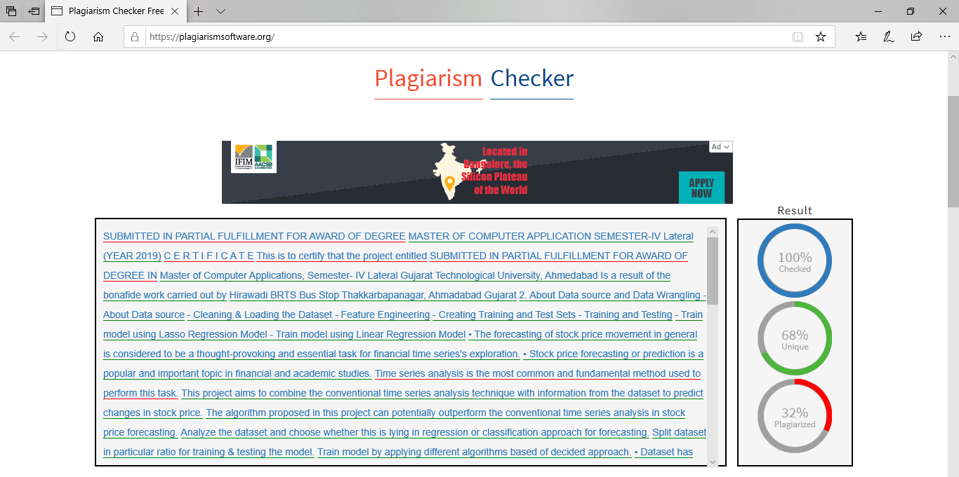
2 . Plagiarism Report

Slide 6
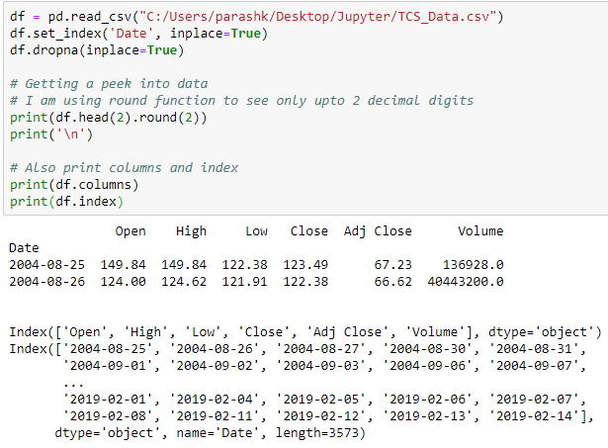
About Data source and Data Wrangling
About Data source
  We have downloaded dataset from Yahoo Finance.
  Dataset has total 7 fields & 3586 records.
  Fields names are Date, Open, High, Low, Close, Adj Close, Volume.
Cleaning & Loading the Dataset
  We have dropped missing or null value in dataset.
  We then have loaded data.

Slide 7
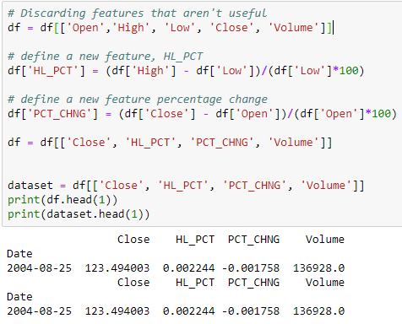
About Data source and Data Wrangling (cont…)
Feature Engineering
  We refined features further based on general understanding of financial data. For instance, instead of dealing with High and Low separately, We created volatility percentages as our new features as shown below:

Slide 8
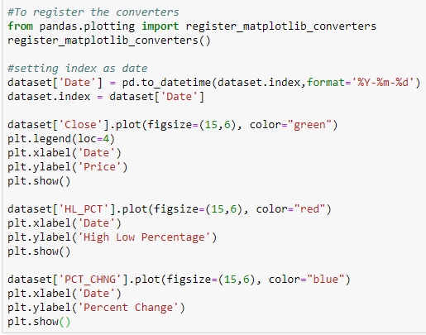
Exploratory Data Analysis
Data Visualization
  We plotted our features as a function of dates, which are saved in the index of our data frame.

Slide 9
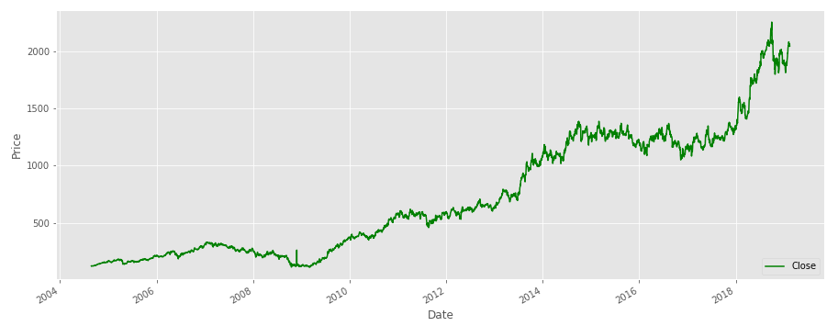
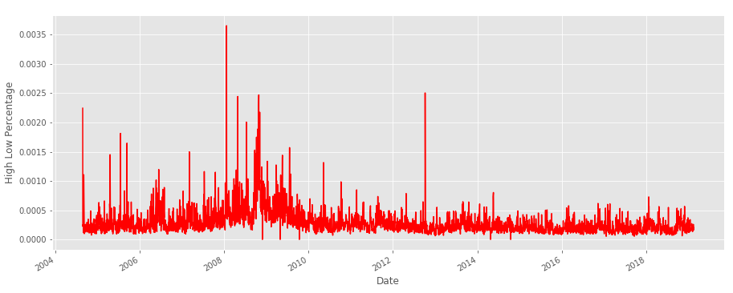
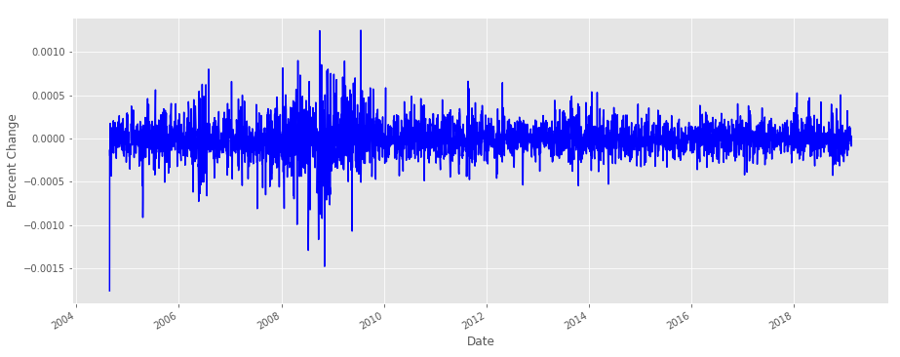
Exploratory Data Analysis(Cont…)

Slide 10
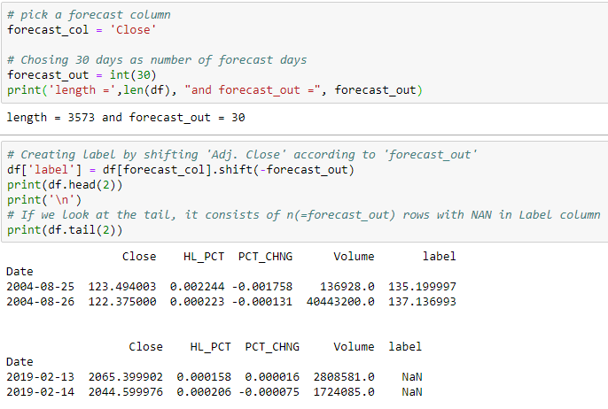
Creating Features and Label
We chose the forecast of ‘Close’, forecast_out after next 30 days for our label (the entity that we want to predict).

Slide 11
Data Science Algorithms Used
Decision Tree
Linear Tree
Lasso Regression

Slide 12
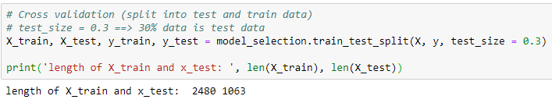
Regression
Creating Training and Test Sets
  Using cross validation basically shuffles the data and according to our test_size criteria, splits the data into test and training data.
Training and Testing
  We first Split the data into 70% of training data and 30% of test data. We then, used certain regression algorithms to train and test data. Finally, we tested the accuracy of my model on the test data.

Slide 13
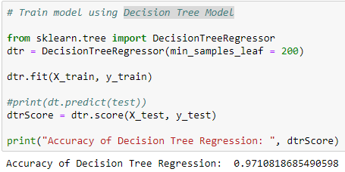
Regression(Cont…)
Train model using Decision Tree Model:
  Decision tree builds regression or classification models in the form of a tree structure. It breaks down a dataset into smaller and smaller subsets while at the same time an associated decision tree is incrementally developed. The final result is a tree with decision nodes and leaf nodes.
  Simple to understand, interpret, visualize.
  Decision trees implicitly perform variable screening or feature selection.
  Can handle both numerical and categorical data. Can also handle multi-output problems.
  Decision trees require relatively little effort from users for data preparation.
  Nonlinear relationships between parameters do not affect tree performance.

Slide 14
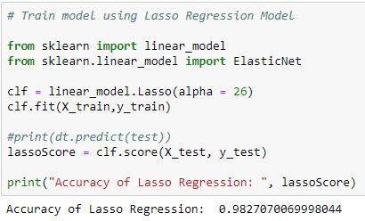
Regression(Cont…)
Train model using Lasso Regression Model
  The acronym “LASSO” stands for Least Absolute Shrinkage and Selection Operator.
  Lasso regression is a type of linear regression that uses shrinkage. Shrinkage is where data values are shrunk towards a central point, like the mean. The lasso procedure encourages simple, sparse models (i.e. models with fewer parameters). This particular type of regression is well-suited for models showing high levels of multicollinearity or when you want to automate certain parts of model selection, like variable selection/parameter elimination.
  The biggest pro of LASSO is that it is better than the usual methods of automatic variable selection such as forward, backward and stepwise - all of which can be shown to give wrong results. The results from LASSO are much better.

Slide 15
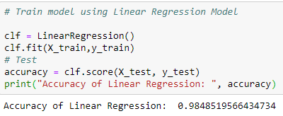
Regression(Cont…)
Train model using Linear Regression Model
  Linear regression is a basic and commonly used type of predictive analysis. This regression estimates are used to explain the relationship between one dependent variable and one or more independent variables. The simplest form of the regression equation with one dependent and one independent variable is defined by the formula y = c + b*x, where y = estimated dependent variable score, c = constant, b = regression coefficient, and x = score on the independent variable.
  An extremely simple method.
  Very easy and intuitive to use and understand.
  Even when it doesn’t fit the data exactly, we can use it to find the nature of the relationship between the two variables.

Slide 16
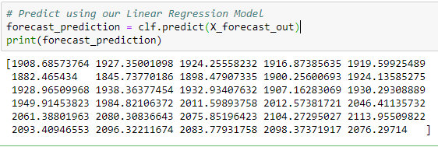
Present Result
Training Accuracy
  We have used three different regression algorithms to train the model. Following are their training accuracy:
Prediction
  It seems like this Linear Regression model did fairly well on the test data set. Now We can go ahead and use this model to predict prices of shares for the next 30 days.
Sr. No. | Training Models | Accuracy
1 | Decision Tree Model | 0.9710818685490598
2 | Lasso Regression Model | 0.9827070069998044
3 | Linear Regression Model | 0.9848519566434734

Slide 17
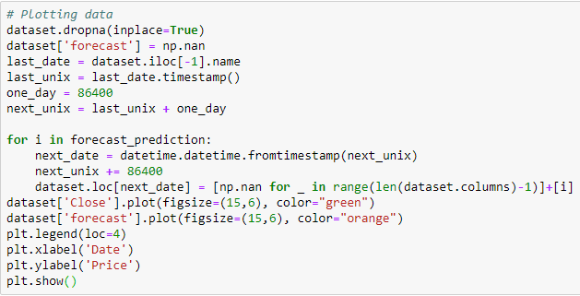
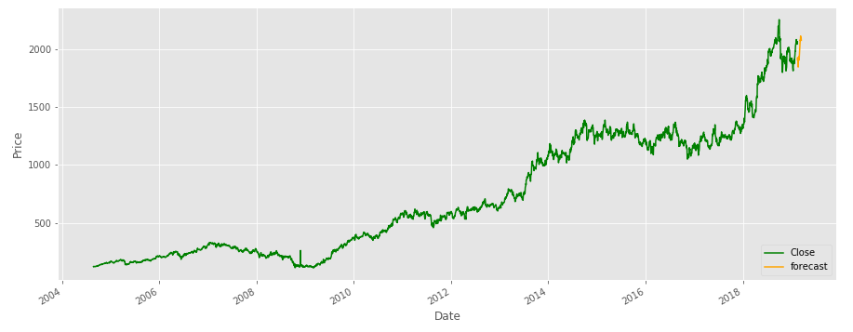
Present Result(Cont…)
Prediction Visualization
  We have plotted the predicted prices as a function of dates. The piece of code below just adds dates for the predicted days.

Slide 18
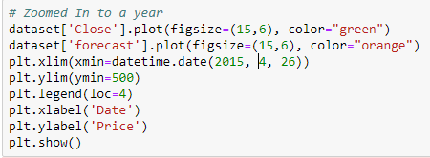
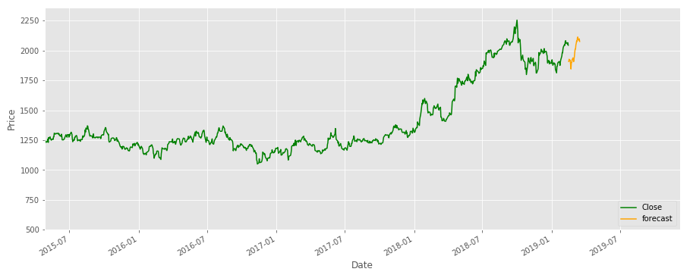
Present Result(Cont…)
Prediction Visualization
  Zoomed In to a Year

Slide 19
Conclusion
We have downloaded TCS company’s historic data.
Analyzed the dataset and decided regression approach for price forecasting.
Split the dataset in training (70%) and testing (30%) model.
Applied three different algorithm to train the model i.e. Decision Tree Regression, Lasso Regression, Linear Regression.
Got best accuracy in Linear Regression model.
Forecast stock price for next 30 days using Linear Regression model.

Slide 20
References
We have taken references to develop this project from following website links:
  https://www.quantinsti.com/blog/decision-tree
  https://www.kaggle.com/dkmostafa/predicting-stock-market-using-linear-regression/code
  http://suruchifialoke.com/2016-08-17-machine-learning-tutorial-with-python-I/
  https://towardsdatascience.com/predicting-stock-prices-with-python-ec1d0c9bece1

Slide 21
Thank You

